Slide 1

Airbag Deployment Alert System Using CAN and GPS
By:
Gopalapuram Varshini
Guruvari Shashi Rekha
Hitesh Daga
Hogade Omkar madam

Slide 2

CONTENTS :
Introduction
Components
Block Diagram
Working Principle
Results
Futurescope

Slide 3
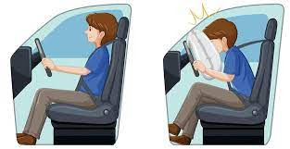
Introduction
An innovative Airbag Deployment Alert System designed to enhance vehicle safety through the fusion of Controller Area Network (CAN) communication and Global Positioning System (GPS) technology.
The system utilizes an ESP board in conjunction with an impact sensor to detect collisions accurately. Upon collision detection, the system triggers the rapid deployment of airbags to mitigate potential injuries to vehicle occupants.
Simultaneously, the integrated GPS module transmits the vehicle's precise location to emergency responders, enabling swift and targeted assistance. By leveraging CAN for internal communication and GPS for external coordination, this system ensures efficient and reliable transmission of critical data in emergency situations.
The seamless integration of CAN and GPS technology offers a robust solution for improving emergency response and reducing the severity of accidents on roadways.

Slide 4
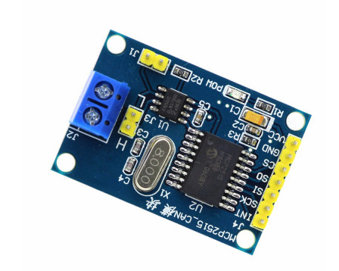
2. Components
CAN (CONTROL AREA NETWORK) –MCP2515-
The MCP2515 is a standalone Controller Area Network (CAN) controller from Microchip Technology. CAN is a communication protocol used primarily in automotive and industrial applications for enabling communication between microcontrollers and devices without a host computer. The MCP2515 provides an interface between a microcontroller and a CAN bus, allowing the microcontroller to communicate with other CAN devices.
Key features of the MCP2515 include:
CAN 2.0B protocol support
SPI interface for communication with the microcontroller
Two receive buffers with prioritized message storage
Three transmit buffers with prioritized message storage
Programmable bit rate up to 1 Mbps
Acceptance filtering for incoming messages
Error detection and handling

Slide 5
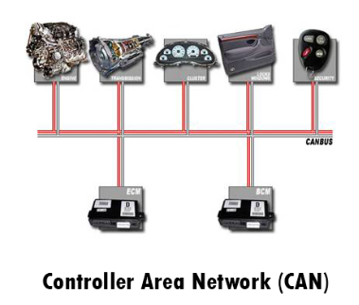
Applications
Automotive Systems
Industrial Automation
Home Automation
Medical Devices
Aerospace and Defense
Telematics
These are just a few examples of the diverse applications of the MCP2515-CAN controller. Its versatility, reliability, and compatibility with a wide range of microcontrollers make it a popular choice in various industries where robust serial communication over a CAN bus network is required.

Slide 6
2.ESP32 BOARD
ESP32 is a chip that provides Wi-Fi and (in some models) Bluetooth connectivity for embedded devices – in other words, for IoT devices. While ESP32 is technically just the chip, the modules and development boards that contain this chip are often also referred to as “ESP32” by the manufacturer.
The ESP32 is most commonly used for mobile devices, wearable tech, and IoT applications, such as Nabto Edge. Moreover, since Mongoose OS introduced an ESP32 IoT Starter Kit, the ESP32 has gained a reputation as the ultimate chip for hobbyists and IoT developers. It’s suitable for commercial IoT, and its capabilities and resources have grown impressively over the past four years.

Slide 7
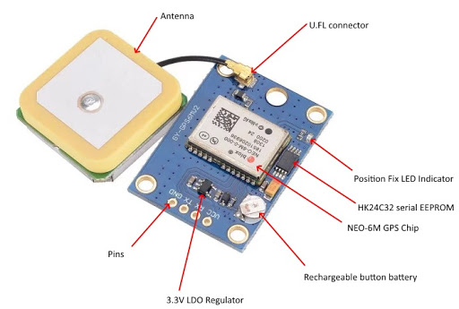
3.NEO-6M GPS
The NEO-6M GPS Module with EPROM is a compact and versatile Global Positioning System (GPS) module that integrates a GPS receiver and non-volatile memory (EPROM) for storing configuration settings or other data.
This module is commonly used in various applications, including navigation, geolocation, tracking, and outdoor positioning.

Slide 8
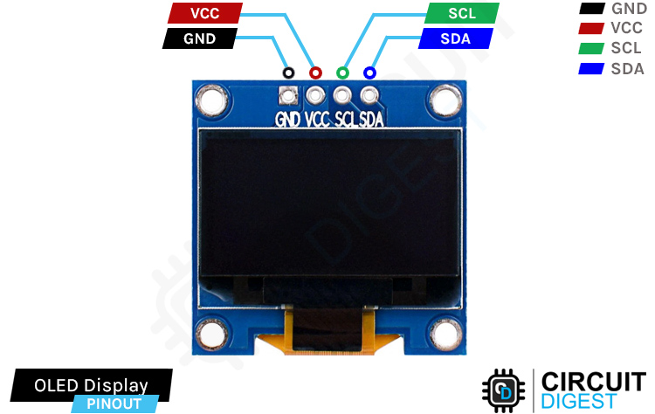
4. OLED
OLED stands for Organic Light-Emitting Diode (OLED). It is also known as organic electroluminescent (EL) diode. OLED is a relatively new type of display for televisions, smartphones, and laptops. After being invented in 1987, OLED is already one of the two top display technologies in the industry. This display technology uses organic (carbon-containing) compounds that emit light when a current is passed through it. Unlike LCD (Liquid Crystal Display) to use RGB (Red, Green, Blue) color filter before white light source to produce full color, an OLED display uses OLED emitters to produce its own light

Slide 9
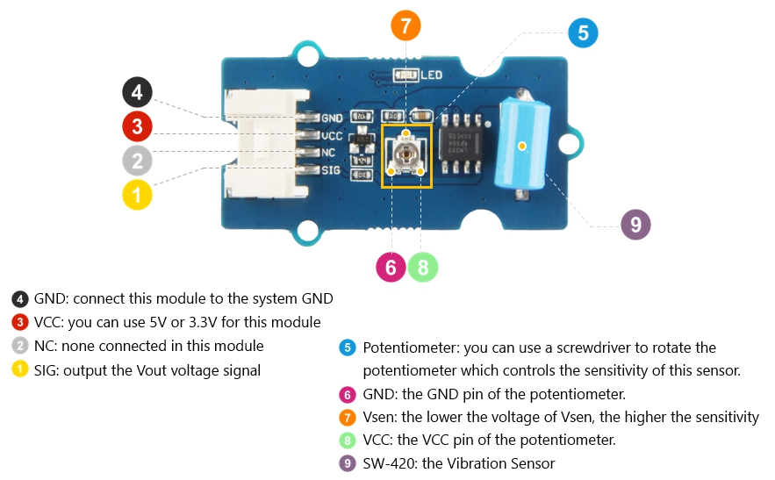
5. Vibration Sensor-
The Grove - Vibration Sensor (SW-420) is a high sensitivity non-directional vibration sensor. When the module is stable, the circuit is turned on and the output is high. When the movement or vibration occurs, the circuit will be briefly disconnected and output low. At the same time, you can also adjust the sensitivity according to your own needs.

Slide 10
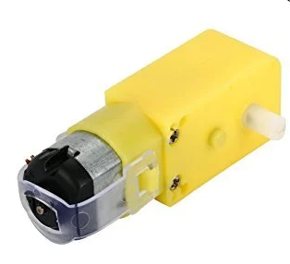
6. DC Motor-
A DC motor is an electrical machine which converts electrical energy into mechanical energy. The basic working principle of the DC motor is that whenever a current carrying conductor places in the magnetic field, it experiences a mechanical force.

Slide 11
6. DC Motor-

Slide 12
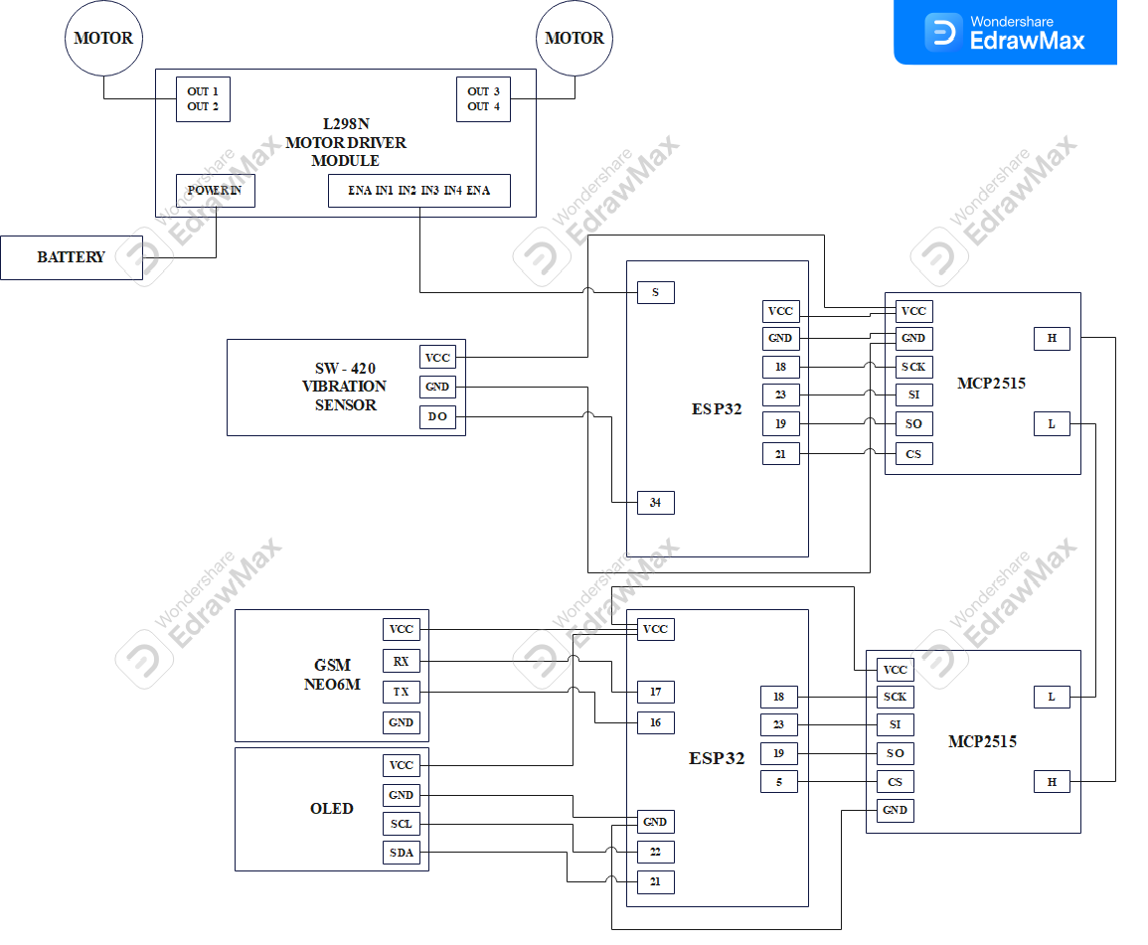
3.Block Diagram

Slide 13
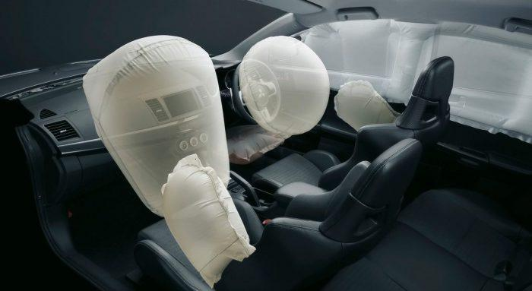
4.Working Principle-
The deployment of an airbag in a vehicle involves a complex process that is initiated by sensors detecting a rapid deceleration or collision event. Here's a simplified overview of the working principle of airbag deployment in a vehicle:
1. Sensor Detection: Modern vehicles are equipped with sensors strategically placed throughout the vehicle, typically in the front bumper area and sometimes in other areas as well. These sensors are designed to detect sudden changes in speed, acceleration, and deceleration that indicate a collision.
2. Collision Detection: When a collision occurs, the vehicle experiences a rapid deceleration. This sudden change in velocity is detected by the sensors, which trigger the airbag deployment system.

Slide 14
3. Signal to Airbag Control Unit (ACU): The sensors send signals to the Airbag Control Unit (ACU) or Airbag Control Module (ACM) located within the vehicle. The ACU is responsible for processing the sensor signals and determining whether airbag deployment is necessary based on the severity and type of collision.
4. Deployment Decision: The ACU analyzes the sensor data to determine the severity and type of collision. It assesses factors such as the speed of the vehicle, the angle of impact, and the force of the collision to decide whether airbag deployment is warranted.
5. Ignition of Inflator: If the ACU determines that airbag deployment is necessary, it sends an electrical signal to the airbag inflator. The inflator contains a small amount of solid propellant or chemical mixture that ignites when an electric current is passed through it.
6. Rapid Inflation: Upon receiving the signal from the ACU, the inflator ignites, producing a rapid and controlled chemical reaction. This reaction generates a large volume of gas (typically nitrogen) that inflates the airbag within milliseconds.

Slide 15
7. Airbag Deployment: The inflated airbag rapidly deploys from its storage location, typically located in the steering wheel (for the driver) or in the dashboard or side panels (for passengers). The deployment is designed to occur within milliseconds of the collision to provide cushioning and protection for the occupants.
8. Occupant Protection: The deployed airbag serves as a cushioning barrier between the occupants and the vehicle interior, helping to reduce the impact forces and mitigate the risk of serious injuries, particularly to the head, chest, and upper body areas.
9. Post-Collision Safety: After deployment, the airbag remains inflated for a brief period to provide continuous protection in case of secondary impacts or multiple collisions. Once the collision forces dissipate, the airbag begins to deflate gradually to prevent suffocation or additional injury to the occupants.
10. Post-Deployment System Check: After the collision event, the vehicle's onboard diagnostic system typically performs a self-check of the airbag system to ensure that all components are functioning correctly and to identify any faults or malfunctions that may require maintenance or repair.

Slide 17
6.Advantages
Deploying airbags using Controller Area Network (CAN) and Global Positioning System (GPS) technologies offers several advantages, especially in terms of improving the effectiveness and efficiency of airbag deployment systems. Here are some advantages of integrating CAN and GPS in airbag deployment:
Real-Time Data Fusion
2. Enhanced Collision Detection
3. Improved Deployment Timing
4. Adaptive Deployment Strategies
5. Reduced False Alarms
6. Enhanced Post-Collision Analysis
7. Telematics and Remote Monitoring
8. Future Autonomous Driving Integration
Overall, integrating CAN and GPS technologies in airbag deployment systems offers significant advantages in terms of improving collision detection accuracy, optimizing deployment timing, reducing false alarms, enhancing post-collision analysis, and laying the groundwork for future autonomous driving safety features.

Slide 18
7.Futurescope
The future scope of airbag deployment systems utilizing Controller Area Network (CAN) and Global Positioning System (GPS) technologies is promising, with several potential advancements and applications on the horizon. Here are some key areas of future development and enhancement:
Advanced Collision Detection Algorithms
Predictive Deployment Strategies
Occupant Position and Biometric Sensing
Adaptive Deployment Control
Integration with Vehicle-to-Infrastructure (V2I) Communication
Enhanced Post-Collision Analysis and Reporting
Integration with Autonomous Driving Systems

Slide 19
Overall, the future scope of airbag deployment systems utilizing CAN and GPS technologies encompasses a wide range of advancements aimed at enhancing collision detection accuracy, optimizing deployment strategies, improving occupant protection, and integrating with emerging vehicle technologies for enhanced safety and collision avoidance capabilities.

Slide 20
THANK YOU

